Slide 1
Quantifying the Impact of Socioeconomic Features on Heart Disease Prevalence
Springboard Capstone Project
Herman Huff

Slide 2
Background
Heart disease is the leading cause of death in the United States, causing more than 600,000 deaths annually.
This project will examine various risk factors for heart disease and seek to determine which combination of factors optimally predict heart disease prevalence per zip code.
Socioeconomic and fast food restaurant datasets will be incorporated.

Slide 3
Impact
This model can help to increase preventative and interventional efforts by identifying new socioeconomic features of heart disease and quantifying the impact of previously known socioeconomic features.
This is beneficial to legislature and organizations seeking to decrease the prevalence of heart disease by giving them new targets to work on and helping to quantify their efforts.

Slide 4
Datasets
500 Cities: Local Data for Better Health
Estimates for disease risk factors, outcomes and preventative service use for the 497 largest cities in America.
810103 entries, each representing a measure of health data for a census tract and 24 columns specifying features of these measures including geographic area information and population counts.
HUD-USPS Crosswalk Files
Contains census tracts and their corresponding zip codes.
Fastfoodmaps.com
Locations of fast food restaurants in the US.
Uszipcode
Data for zip codes including demographic, real estate and socioeconomic.

Slide 5
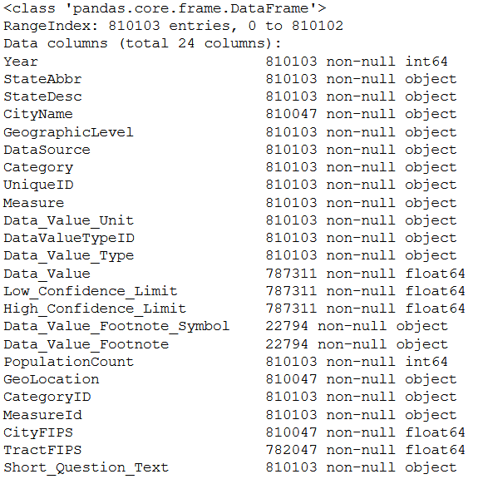
Data Wrangling – 500 Cities
810103 entries
24 Columns
Dropped missing values (due to low population)
Rows filtered to contain heart disease risk factors

Slide 6
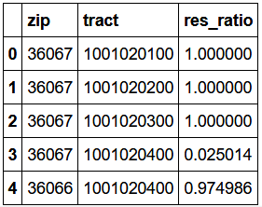
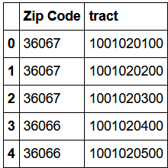
Data Wrangling – HUD-USPS Zip Crosswalk
Some census tracts are within multiple zip codes
Maximum resident ratio value is selected and merged with the dataset, resulting in only one zip code for each census tract
↓

Slide 7
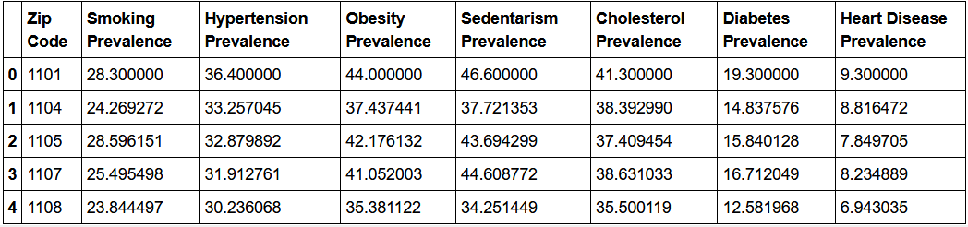
Merging 500 Cities and Zip Crosswalk
The datasets are merged
Prevalence by population is obtained by taking census tract means weighted by population

Slide 8
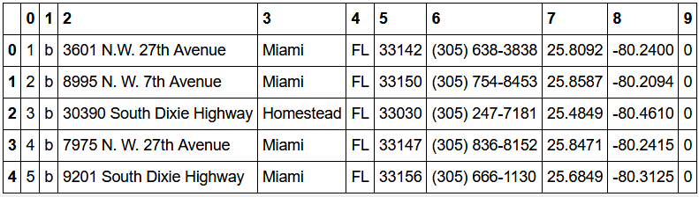
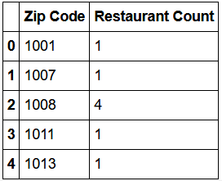
Data Wrangling – Fastfoodmaps.com
Zip codes are reformatted to contain only 5 digits
A sum of restaurants is obtained after grouping by zip code
↓

Slide 9
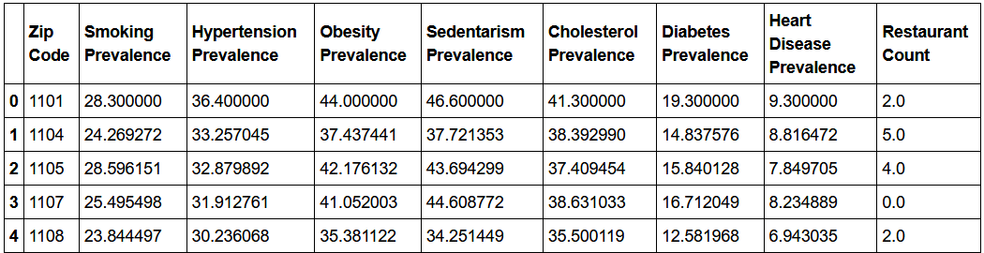
Data Wrangling - Merging in restaurant count

Slide 10
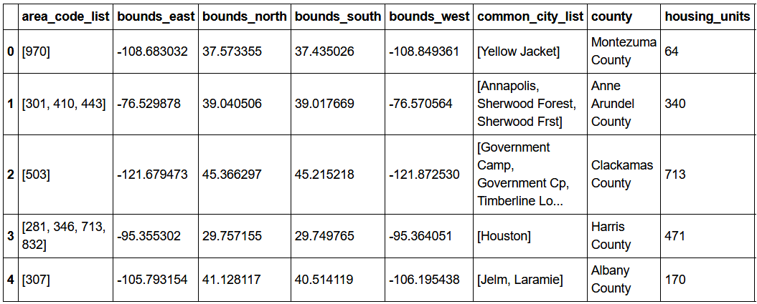
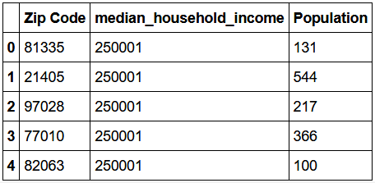
Data Wrangling - Uszipcode
Zip code populations and household income are selected
↓

Slide 11
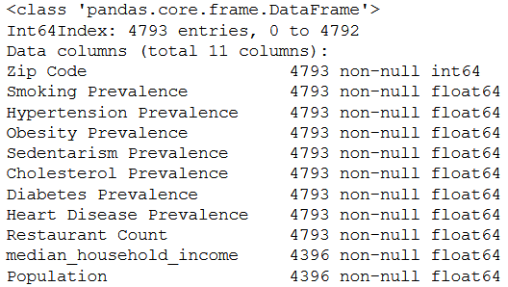
Data Wrangling - Merging in uszipcode
Missing values for income and population will be imputed later

Slide 12
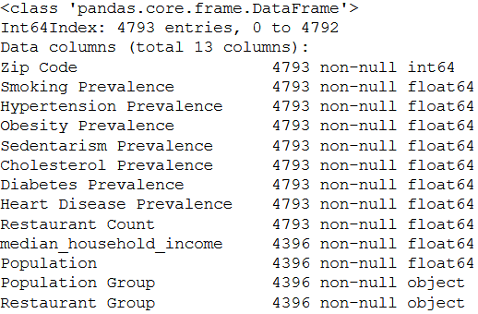
Feature engineering
Two new columns are created, designating groups for population and income

Slide 13
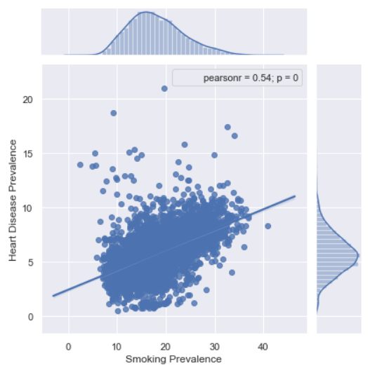
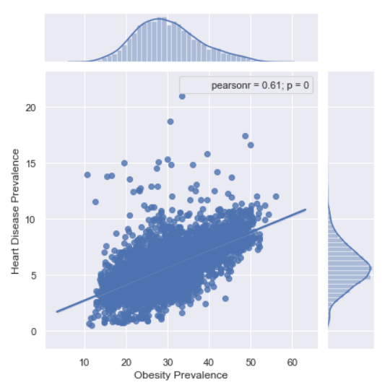
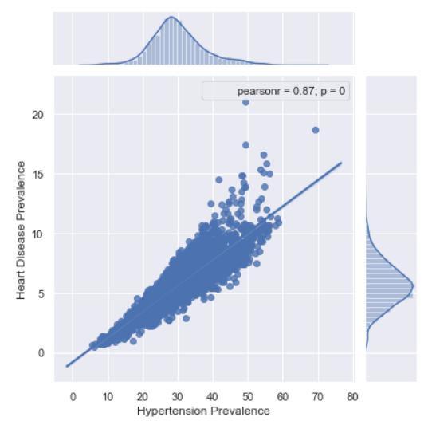
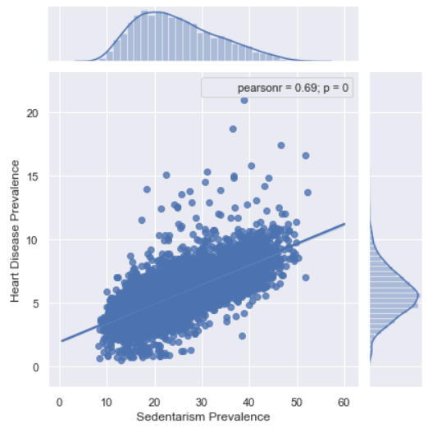
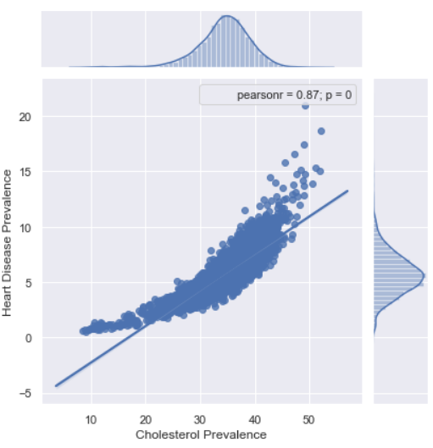
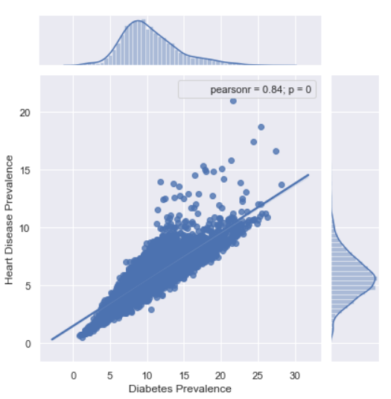
Data Story – Strongly correlated known risk factors

Slide 14
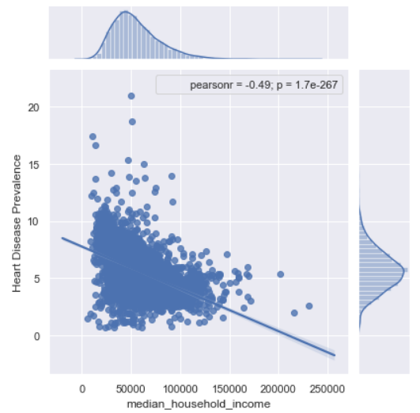
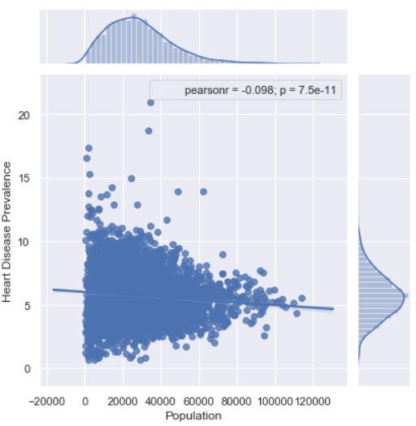
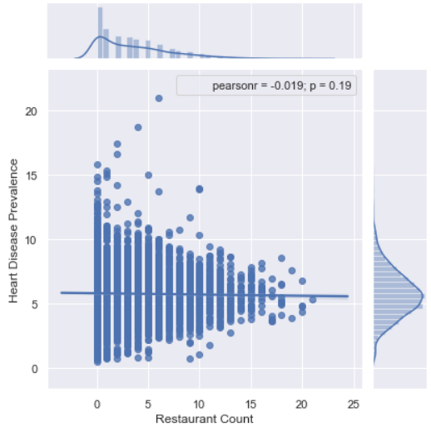
Data Story - Socioeconomic
Strong negative association between disease and income
Slight negative association between disease and population
Likely no association between disease and restaurant count

Slide 15
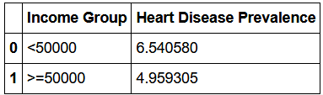
Inferential Statistics – Income groups
Is the observed difference in the samples due to chance?
Null Hypothesis: There is no difference in the mean heart disease prevalence between groups.
Alternative Hypothesis: The mean heart disease prevalence is higher when median household income is <50000.
alpha = 0.05
p = 0.0
A p-value close to 0 indicates we reject the null hypothesis. There is a difference in the means of both groups.

Slide 16
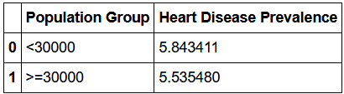
Inferential Statistics – Population groups
Is the observed difference in the samples due to chance?
Null Hypothesis: There is no difference in the mean heart disease prevalence between groups.
Alternative Hypothesis: The mean heart disease prevalence is higher when population < 30000.
alpha = 0.05
p = 0.0
A p-value close to 0 indicates we reject the null hypothesis. There is a difference in the means of both groups.

Slide 17
Data Story/Inferential Statistics - Summary
The following features have moderate to strong correlations with heart disease prevalence and will be useful for our model:
High cholesterol prevalence
Hypertension prevalence
Diabetes prevalence
Sedentarism prevalence
Obesity prevalence
Smoking prevalence
Median household income
Population
Restaurant count per zip code may not be helpful for our model. It has a very weak correlation with heart disease prevalence in populations < 30000.

Slide 18
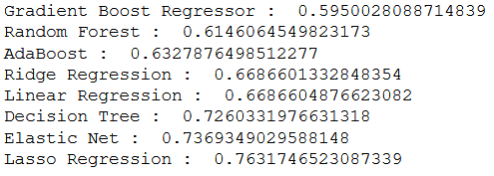
Machine Learning – Default performance
Using RMSE scoring, gradient boosting had the best default (un-tuned) performance followed by a random forest
Both estimators should be evaluated for improved performance through tuning

Slide 19
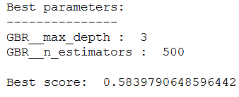
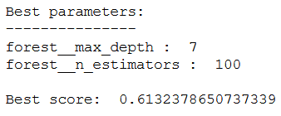
Machine Learning – Hyperparameter tuning
Gradient Boosting Random Forest
Gradient boost regression provides the best score before and after tuning

Slide 20
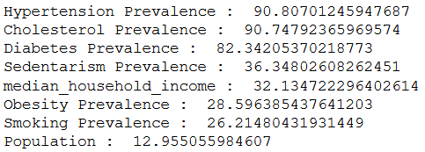
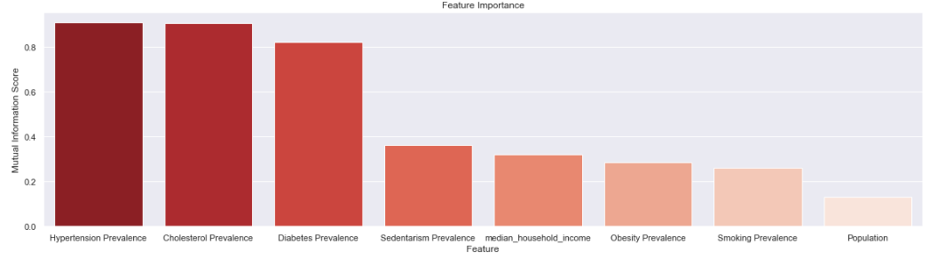
Machine Learning – Feature importance
Mutual information scoring is used to examine the importance of features

Slide 21
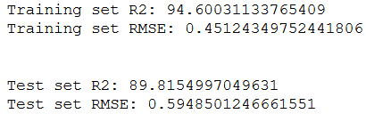
Machine Learning - Final model
The gradient boosting model shows good R^2 and RMSE scores on the training and test sets

Slide 22
Machine Learning - Conclusion
Median household income is approximately as strong of a predictor as well-known risk factors, smoking and obesity. Population contributes minimally to prediction.
The test set performance indicates the model will work well on general data
Further hyperparameter tuning may risk overfitting to the training set

Slide 23
Machine Learning - Recommendation
This model can be taken further by incorporating additional socioeconomic features such distance and means of transportation to work, education levels and home values.
The model may provide more insight using an updated dataset for fast food restaurant locations within the US.

